Slide 1
Brexit: Consequences for Trade, VAT and Customs
Ilona van den Eijnde
Academic teacher Global Trade (Erasmus School of Law)
Researcher & author (IBFD Special Tax Zones, Kluwer)
Global Trade & Indirect Tax Advisor (EY)

Slide 2
Agenda
Introduction
Three customs scenario’s of Brexit
and their why’s and won’ts
Indirect Tax compliance in a post-Brexit world
The Irish Border in the Press
Questions / discussions

Slide 3
Introduction

Slide 4
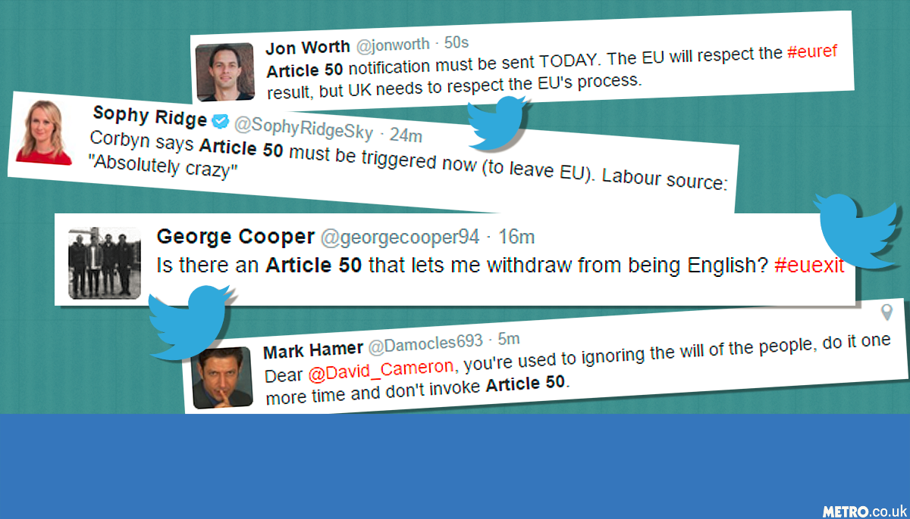
Article 50?

Slide 5
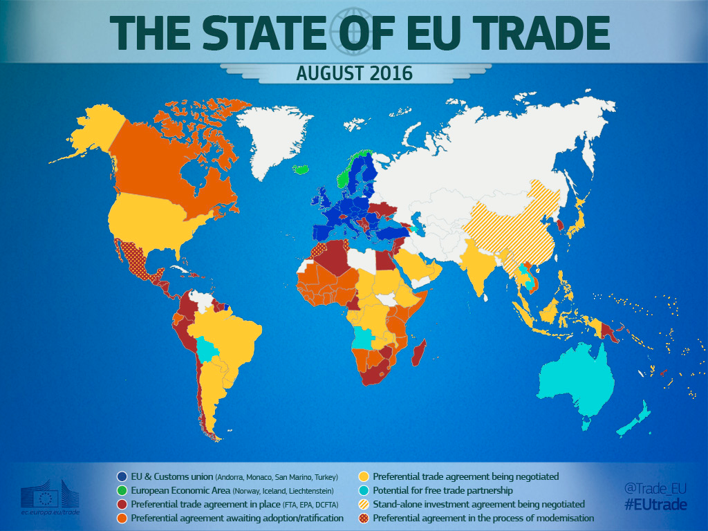

Slide 6
Timetable EU negotiation examples
Country | Start negotiations | Agreement | Timeline
Canada | May 2009 | July 2016 | 7 years, 2 months
Japan | March 2013 | December 2017? | 4 years, 9 months
Mercosur | May 2010 | - | 7 years, 6 months +
Mexico (1997) | May 2016 | - | 1 year, 6 months +
Peru | March 2011 | June 2012 | 14 months
South Africa (2007) | February 2007 | June 2016 | 9 years, 4 months
Turkey (1995) | March 1996 | - | 21 years, 6 months +
United States | April 2007 | - | 10 years, 5 months +

Slide 7
Three scenario’s of Brexit and their why’s and wont’s

Slide 8
Customs Union
CU
FTA
WTO
X
Currently with Turkey (Ankara Association Agreement, 1963)
Not applicable: EU internal market (free movement of persons) and flanking policies; common security and defense policy
Applicable: EU customs union (EU common external customs tariff), common agricultural & fisheries policies, common trade policy,
No participation in EU decision making, no access to European Court of Justice and other EU institutions

Slide 9
Tailor-made trade agreement
CU
FTA
WTO
X
Types of tailor made agreements with the EU
  Stabilisation and association agreements
  Economic Partnership agreements
  Partnership and cooperation agreements
  Trade agreements
Examples
  Comprehensive Economic and Trade Agreement (CETA, 2016)
  EU-Singapore Free Trade Agreement (EUSFTA)
  Transatlantic Trade Investment Partnership (TTIP)
  Trade in Services Agreement (TiSA)

Slide 10
Fallback scenario
CU
FTA
WTO
X
WTO rules: basic terms of trade, rather than extensive market integration
Customs duty rates apply to imports from all countries that do not have FTA with UK
To what extent do the WTO rules apply automatically to the UK once it has left the EU?

Slide 11
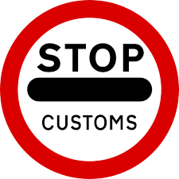


Three scenario’s of Brexit
Scenarios
1
2
3
Customs Union
Free Trade Agreement
Third Country (WTO)
No customs duties
Additional customs formalities
Import VAT, VAT formalities and VAT cash flow
Additional customs duties
Additional customs formalities
Import VAT, VAT formalities and VAT cash flow
Additional customs duties
Additional customs formalities
Import VAT, VAT formalities and VAT cash flow
Example: Turkey
Examples: Switzerland, Norway, South Africa, Korea & Mexico
Example: Russia, USA, Japan, China

Slide 12
Indirect Tax Compliance in a Post-Brexit World

Slide 13
Customs implications
CU
FTA
WTO
X
X
X
The scenarios of Free Trade Agreements (FTAs) and WTO result in the levying of customs duties
WTO-scenario results in an average of 3% import duties (non-refundable)
Customs duties
Administrative costs
All scenarios result in additional administrative costs
Customs classification and valuation compliance costs
Imports / Exports
Every EU-UK/UK-EU transfer of goods will result in import and export
In all scenarios this will result in customs formalities (delays and costs)
EU FTAs
All EU-FTAs are no longer applicable for the UK
UK needs to negotiate new FTAs, this generally takes a long time
EU origin
UK Products will lose EU origin
Products predominantly from UK components no longer qualify for EU FTAs
Customs
valuation
Application of customs valuation rules will be necessary
Inclusion of royalties, R&D costs etc in customs value may be necessary
EU Licenses / Authorisations
Customs licenses / authorisations (e.g. license for export) will not be available for UK entities
UK Distribution center
Most EU-FTAs require direct transport to the EU
If goods are transported via a UK distribution center, it may not always possible to benefit from the EU FTA

Slide 14
VAT implications
CU
FTA
WTO
X
X
X
Contrary to VAT on intra-EU Trade, import VAT is always due and must be financed
Some countries have facilitations to off-sett import VAT (e.g. NL), however foreigners must have a fiscal representative and/or set a bankguarantee
Import VAT
EU VAT refunds
Normal refund procedures no longer apply, EU countries can invoke reciproxity and put additional requirements on VAT refunds, so can the UK.
Every EU-UK/UK-EU transfer of goods will be imports and exports resulting in VAT and customs formalities (delays and costs)
Impact for semi-finished goods, repairs, consignments, research and similar activities in the UK.
Movement of own goods
eCommerce and distance sales
UK based or registered entities may no longer use the EU simplifications (e.g. Mini One Stop Shop VAT registration) – new VAT reporting needs to be set-up.
Administration abroad
EU based companies may face limitations to keep administration in the UK.
Impact on UK shared service centers and headquarters.
Financial services
Material impact on partial VAT deduction right for UK banks operating in Europe and vice versa
EU law and jurisprudence will no longer be binding resulting in uncertainty and potential deviations of rates, VAT treatments of transactions and industries.
No protection against double taxation (VAT)
Legal certainty
Real borders
Northern Ireland-Ireland, Dover-Calais and Gibraltar-Spain will have real land borders and border control
Effective Use and enjoyment
Services between EU and UK may attract (irrecoverable) local VAT based on Effective Use and Enjoyment rules

Slide 15
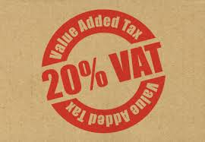
Practical implications
B2B sales
Export BV
Import Ltd
Pre Brexit:
Export BV reports intra-EU supply at 0% VAT (no customs duty/formalities)
Import Ltd reports intra-EU acquisition at standard UK rate (no customs duty/formalities)
Intrastat & EC Sales listing (if thresholds are exceeded)

Slide 16
Practical implications
B2B sales
CU
FTA
WTO
X
Export BV
Import Ltd
Post Brexit:
Export BV reports export supply at 0% VAT and drafts Carnet (mind Incoterms)
Import Ltd reports import at standard UK VAT rate
No customs duty, no Intrastat & no EC Sales listing

Slide 17
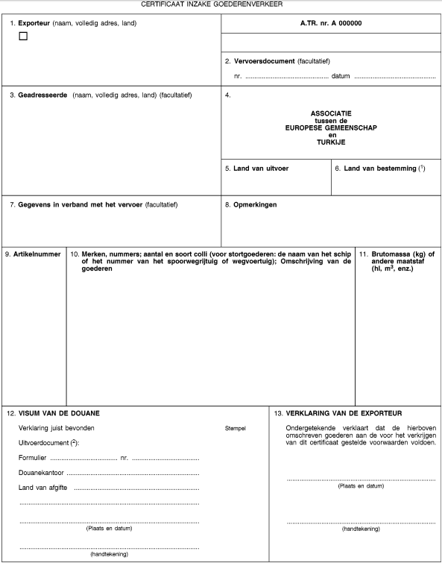
Name & Address
Export BV
Name & Address
Consignee
Product reference number
Description of the goods
(CN not required)
Gross weight
Signature

Slide 18
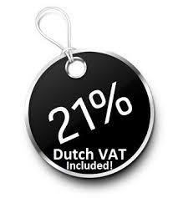

Practical implications
B2B sales – for EU Manufacturers
Raw Sarl
Export BV
(producer)
Import Ltd
Mat Inc
Pre Brexit:
Export BV imports materials from US, customs duty/formalities and 21% import VAT applies
Export BV reports intra-EU acquisition at 21% Dutch VAT (no customs duty/formalities)
Export BV reports intra-EU supply at 0% VAT (no customs duty/formalities)
Import Ltd reports intra-EU acquisition at standard UK rate (no customs duty/formalities)
Intrastat & EC Sales listing (if thresholds are exceeded)

Slide 19
Practical implications
B2B sales – for EU manufacturers
CU
FTA
WTO
X
Raw Sarl
Export BV
(producer)
Import Ltd
Mat Inc
Post Brexit:
Export BV imports materials from US, customs duty/formalities and 21% import VAT applies
Export BV reports intra-EU acquisition at 21% Dutch VAT (no customs duty/formalities)
Export BV reports export supply at 0% VAT, files export declaration and drafts EUR1
Import Ltd files import declaration (duty free*) and reports import at standard UK VAT rate

Slide 20
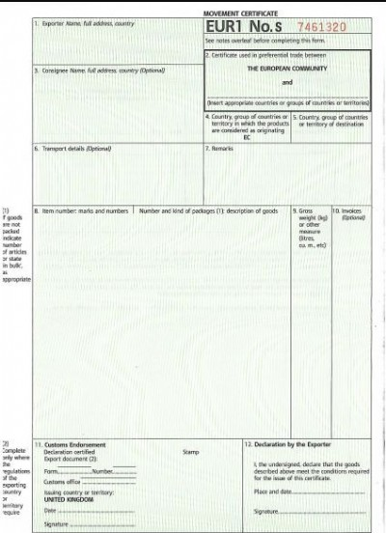
Name & Address
Export BV
Name & Address
Consignee
Countries of origin
Product reference number
Description of the goods
(CN required)
Gross weight
Signature

Slide 21
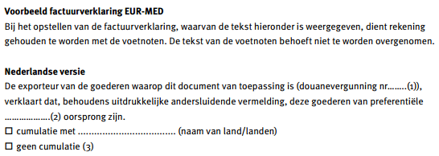
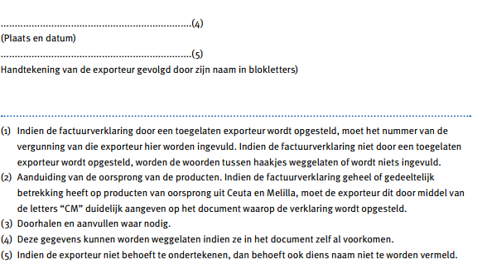
To be included on invoice raised by exporter or on transport documentation
Approved exporter’s license required
Signature & Name
Export BV

Slide 22
Practical implications
B2B sales – for EU manufacturers
CU
FTA
WTO
X
X
Raw Sarl
Export BV
(producer)
Import Ltd
Mat Inc
Post Brexit:
Export BV imports materials from US, customs duty/formalities and 21% import VAT applies
Export BV reports intra-EU acquisition at 21% Dutch VAT (no customs duty/formalities)
Export BV reports export supply at 0% VAT, files export declaration and drafts COO
Import Ltd files import declaration (+customs duty) and reports import at standard UK VAT rate

Slide 23
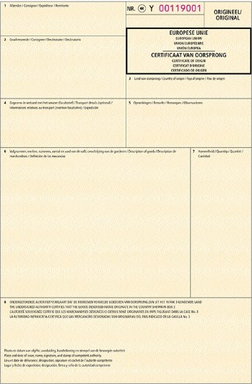
Name & Address
Export BV
Name & Address
Consignee
Countries of origin
Product reference number
Description of the goods
(CN required)
Signature/Stamp

Slide 24
Practical implications
B2B sales – for EU manufacturers (optimized)
CU
FTA
WTO
X
Raw Sarl
IPR
Export BV
(producer)
Import Ltd
Mat Inc
Post Brexit:
Export BV places materials from US under inward processing relief (no duty, 0% VAT)
Export BV reports intra-EU acquisition at 21% Dutch VAT (no customs duty/formalities)
Export BV reports export supply at 0% VAT, files export declaration and drafts COO
Import Ltd files import declaration (+customs duty) and reports import at standard UK VAT rate

Slide 25
Practical implications
B2B sales – for EU traders
Raw Sarl
Export BV
(trader)
Import Ltd
Mat Inc
Pre Brexit:
Export BV imports materials from US, customs duty/formalities and 21% import VAT applies
Export BV reports intra-EU acquisition at 21% Dutch VAT (no customs duty/formalities)
Export BV reports intra-EU supply at 0% VAT, Intrastat, EC Sales listing
Import Ltd reports intra-EU acquisition at standard UK VAT rate, Intrastat, EC Sales listing

Slide 26
Practical implications
B2B sales – for EU traders
CU
FTA
WTO
X
X
Raw Sarl
Export BV
(trader)
Import Ltd
Mat Inc
Post Brexit:
Export BV imports materials from US, customs duty/formalities and 21% import VAT applies
Export BV reports intra-EU acquisition at 21% Dutch VAT (no customs duty/formalities)
Export BV reports export supply at 0% VAT, files export declaration and drafts COO (no EUR1!!)
Import Ltd files import declaration (+customs duty*) and reports import at standard UK VAT rate

Slide 27
Practical implications
B2B sales – for EU traders (optimized)
CU
FTA
WTO
X
X
Raw Sarl
CW
Export BV
(trader)
Import Ltd
Mat Inc
Post Brexit:
Export BV places materials from US under customs warehousing regime, no customs duty and 0% import VAT applies
Export BV reports intra-EU acquisition at 21% Dutch VAT (no customs duty/formalities)
Export BV reports export supply at 0% VAT, files export declaration and drafts COO (no EUR1!!)
Import Ltd files import declaration (+customs duty*) and reports import at standard UK VAT rate

Slide 28

Practical implications
Distance sales
Export BV
UK customer
Pre Brexit:
Export BV does not exceed threshold £70,000 → Dutch VAT
Export BV does exceed threshold £70,000 or opts in for distance sales regime → UK VAT (incl. UK VAT registration obligation)

Slide 29
Practical implications
Distance sales
CU
FTA
WTO
X
Export BV
UK customer
Post Brexit:
Export BV transfers goods to UK → 0% Dutch VAT + Carnet
Import VAT upon arrival in UK; border control, but no duty

Slide 30
Practical implications
Distance sales
CU
FTA
WTO
X
X
Export BV
UK customer
Post Brexit:
Export BV exports goods to UK → 0% Dutch VAT + export formalities
Import into UK (VAT+duty); but import formality issues in UK:
  Customer to settle duty/VAT under postal regime (postal service act as importer)
  Export BV to appoint representative to settle duty/VAT on its behalf

Slide 31
Other considerations
EU Court of Justice
  New case law shall no longer apply to UK situation
  Transitional period unknown (no access would be illegal state act)
EU Conformity regulations
  “Bend of a banana” rules no longer apply to import into UK
  UK may impose new / deviating conformity legislation
EU Anti-dumping regulations
  UK no longer levies EU anti-dumping duties
  EU may impose anti-dumping duties on UK products
  UK may impose anti-dumping duties on EU products
Customs classification
  UK Binding Tariff Informations (invalid)
  Determine classification codes (if first exports)
Customs valuation
  In addition to TP, customs valuation rules apply to intercompany transactions
Customs origin
  EU manufacturers must track origin status if foreign raw materials are used
  Direct transportation rule
Excise duty
  UK no longer obliged to comply with EU harmonized excises on tobacco, alcohol, oil/gas/electricity
  UK free to impose other trade barriers on specific (EU manufactured…) products

Slide 32
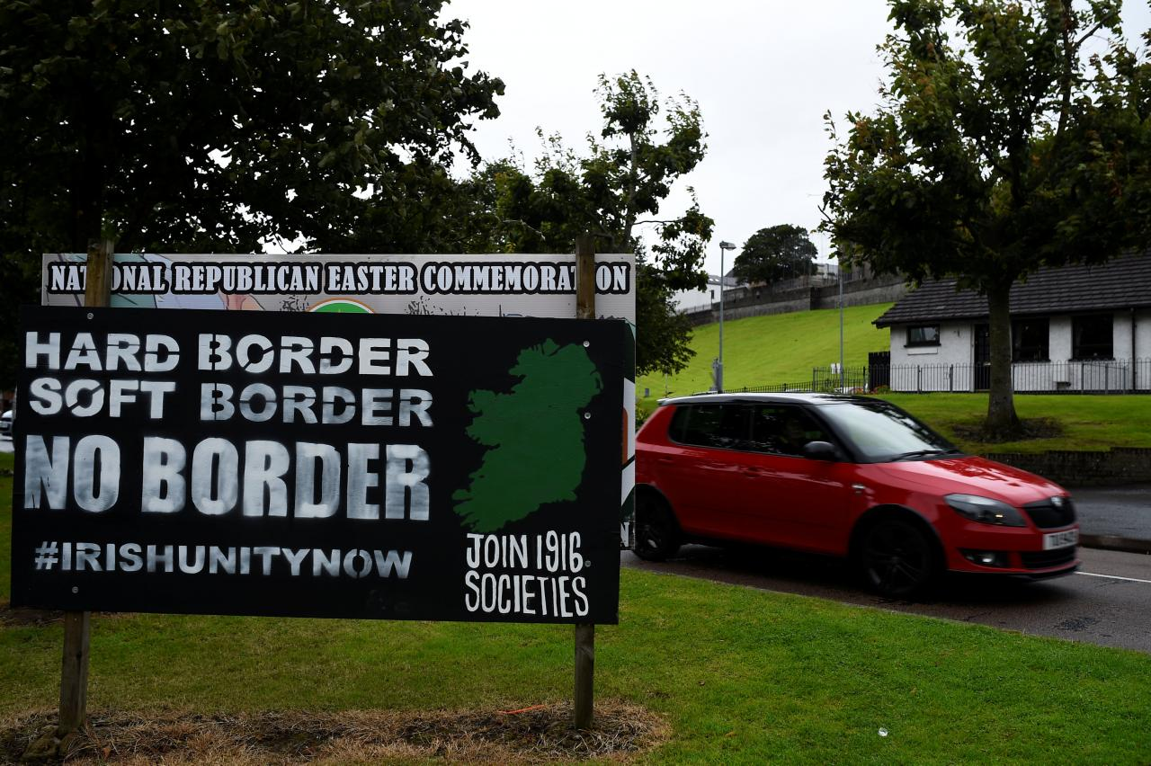
The Irish Border

Slide 33
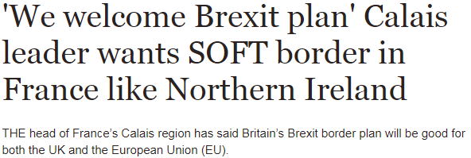
The Irish Border
Not happening:
No border controls between Northern Ireland & Ireland
Customs compliance requirements or duty rates for NIRL border that are more favourable than other EU customs compliance
Further problems:
Happening?
Electronically enabled “green lanes” for imports of goods that have been prescreened or that are imported by registered importers (e.g. AEO)
Northern Ireland, as a whole, to become a Free Trade Zone, collecting no customs duty upon import and customs compliance can be “light”
Discussions with the world’s largest Free Zone, Jebel Ali in Dubai, have been initiated

Slide 34
Questions?
Ilona van den Eijnde
ilona.van.den.eijnde@nl.ey.com
+31 (0)6 2125 1475
Slides shall be circulated

