Slide 1
Special Tax Zones within a non-tax jurisdiction
Ms. Ilona van den Eijnde LL.M
Erasmus School of Law
Researcher United Arab Emirates

Slide 2
Non-tax jurisdiction?
 | United Arab Emirates | Netherlands | USA
Ease of doing business ranking* | # 26 | # 28 | # 8
Ease of starting business* | # 53 | # 22 | # 51
Trading across borders* | # 85 | # 1 | # 36
Paying Taxes* | # 1 | # 20 | # 35
Corporate income tax rate | 0%** | 20 - 25% | 15 - 35%
Personal income tax rate | 0% | 36,55 - 52% | 10 - 39,6%
Value added tax rate | 5% (2018) | 6 / 21% | 0 - 7,5%
Customs duty rate (MFN av.) | 4,7% | 4,8% (EU) | 3,5%

Slide 3
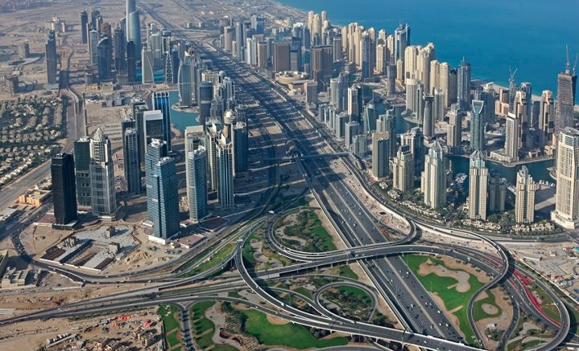
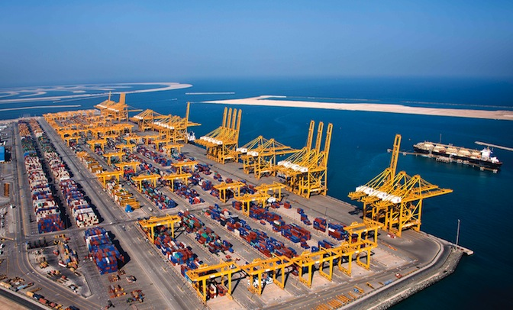
Main goals to use UAE Free (Trade) Zones
Customs bonded storage
& VAT deferral (2018)
100% foreign ownership

Slide 4
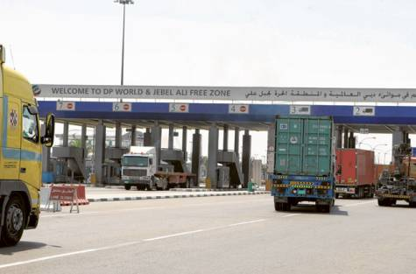
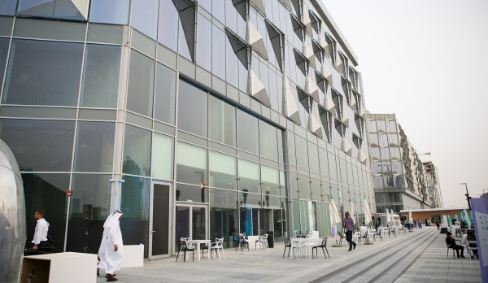
UAE Free Trade Zones
10 out of 40 are “bonded”
Largest hosts 9,000+ companies
Most near air/seaports
Most allow & facilitate manufacturing
Stringent administrative requirements
Physical & controlled gates
No direct mainland trading allowed
“Hybrid” zones under construction (Dubai Design District)

Slide 5
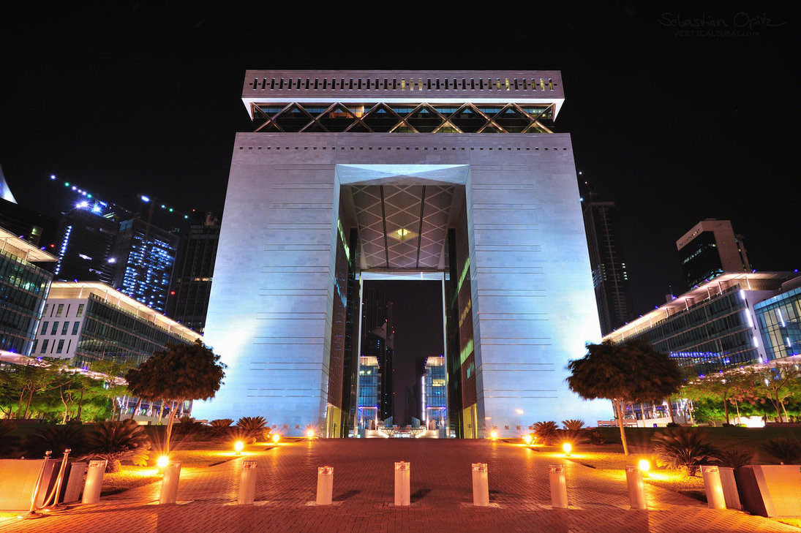
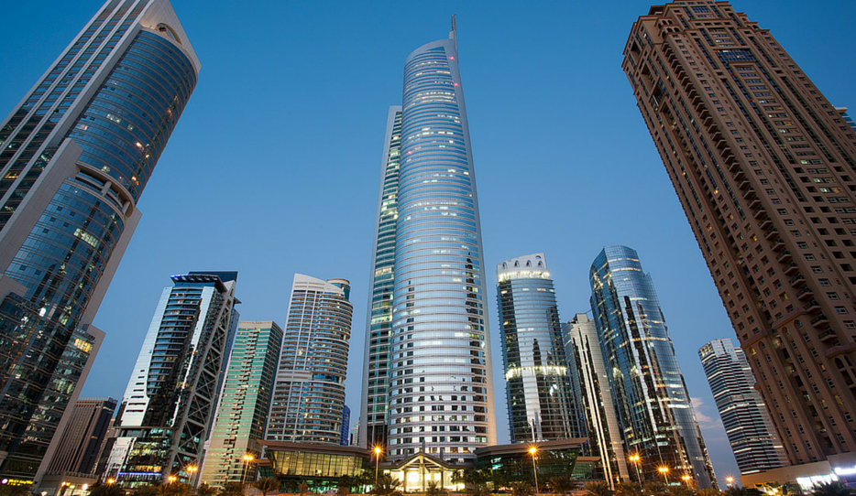
UAE Free Zones
30 out of 40 are not “bonded”
Mostly industrial & commercial (including financial/commodity)
Themed facilities/licensing:
  Gold & Diamond Park
  Commodity Centre
  Media/Internet City
  International Finance Centre
Minimal administrative requirements
No physical & controlled gates
No direct mainland trading allowed

Slide 6
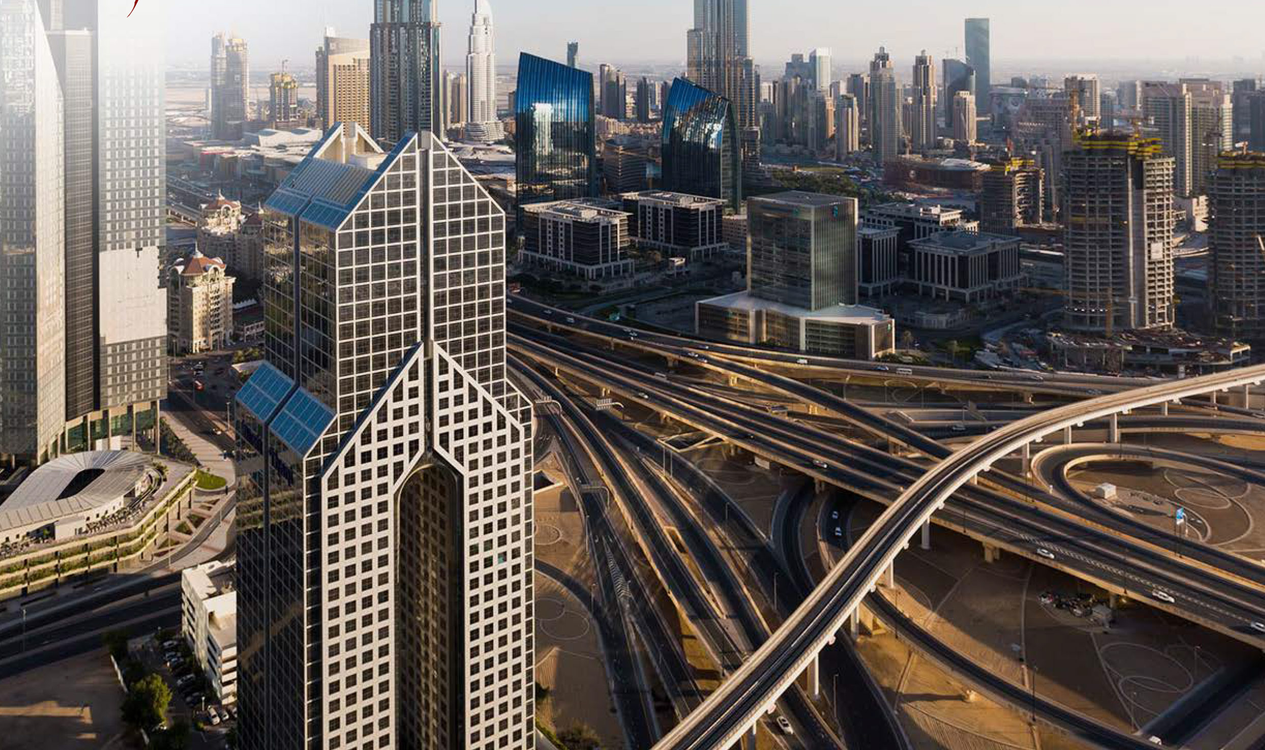
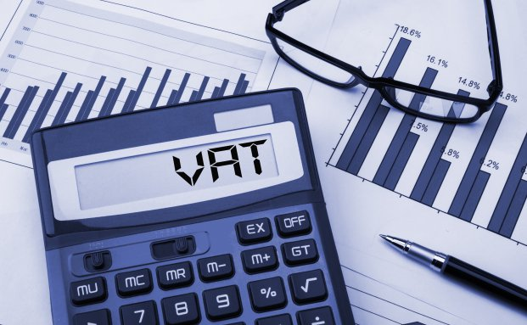
Identified “trends”
Significant STZ presence (10%)
  Only 5 customs warehouse licensees in UAE mainland
Significant STZ economic activities (33% GDP)
Mainly attracts those that cannot operate in the mainland under similar conditions:
  Expatriate investors
  Banks & Financial institutions
  International traders (hub)
Challenges ahead: VAT & other taxes

