Slide 1


Strategies for Property Tax Reform
Arjen Schep LLM, PhD
Academic Researcher
Erasmus Study Center for Taxes of Sub Central Governments (ESBL)
schep@law.eur.nl www.linkedin.com/in/awschep

Slide 2




1. Introduction
Introduction Arjen Schep
This presentation:
valuation or assessment technique
technical elements of property tax
(elements for) strategies for Property Tax (PT) reform
Based on:
Academic literature
Own research
Africa project VNG international
Beforehand: no ‘silver bullet’ strategy available
Goal: Insight in specific challenges in PT Reform and able to translate these into a possible strategy for own specific situation

Slide 3
Presentation outline
Introduction
Basic elements of a good property tax - 2.1 A good tax in general - 2.2 A good local tax - 2.3 Why don’t property taxes live up to their expectations?
Central & Local government relations - 3.1 Central or Local Property Tax - 3.2 Intergovernmental transfers - 3.3 Tax revenue autonomy & fiscal capacity of local governments
Strategies for PT Reform - 4.1 General Strategies - 4.2 Necessary conditions for successful PT Reform - 4.3 Collection Led Strategy vs. Valuation Pushed Strategy - 4.4 Property Tax Administration - 4.5 Building a taxpayers culture - 4.6 Role of decentralization in PT Reform
Conclusions
Example from VNG International in Ghana

Slide 4

2. Basic elements of a good property tax A good tax in general (1)
Efficiency
No distortions of adequate allocation of resources
‘Benefit principle’ is applied
Equity and fairness
Horizontal equity: equal treatment of taxpayers
Vertical equity: ‘ability to pay principle’ is applied
Revenue adequacy
High revenue/low collection costs
Tax base is stable

Slide 5
2. Basic elements of a good property tax A good tax in general (2)
Low costs of administration and compliance
Administration costs reduce revenue
Compliance costs reduce available income
Political acceptability
Cooperation of relevant agents & institutions required to prevent:
Low voluntary compliance
Inadequate laws
Deficient enforcement
Minimize tax avoidance and tax evasion
No legal or illegal eluding of tax burden (relation with fairness of tax and with enforcement)

Slide 6

2. Basic elements of a good profit tax A good local tax
Visibility of tax instrument
Both weakness and strength
Immovability of tax base
Prevent taxpayers ‘voting with their feet’
No ‘race to the bottom’
Geographic neutrality
No interference with commercial goods & services and business location decisions across jurisdictions
No exportation of taxes
Avoid charging of non-residents (contrary to benefit principle)
Even distribution of tax revenue sources among jurisdictions

Slide 7

2. Basic elements of a good property tax Why don’t property taxes live up to their expectations?
Low level of fiscal decentralization
Resistance from property-owning elites
Poor tax administration
Narrow tax base
Ineffective tax assessment
Low tax rates
Taxpayers’ attitude
Weak enforcement

Slide 8
Presentation outline
Introduction
Basic elements of a good property tax - 2.1 A good tax in general - 2.2 A good local tax - 2.3 Why don’t property taxes live up to their expectations?
Central & Local government relations - 3.1 Central or Local Property Tax - 3.2 Intergovernmental transfers - 3.3 Tax revenue autonomy & fiscal capacity of local governments
Strategies for PT Reform - 4.1 General Strategies - 4.2 Necessary conditions for successful PT Reform - 4.3 Collection Led Strategy vs. Valuation Pushed Strategy - 4.4 Property Tax Administration - 4.5 Building a taxpayers culture - 4.6 Role of central government in PT Reform
Conclusions
Example from VNG International in Ghana

Slide 9
3. Central & Local government relations 3.1 Central or local property tax?
Principle | Central PT | Local Gvmt PT
Efficiency | - | +
Equity and Fairness | + | -
Revenue Adequacy | + | -
Low adminstration costs | +/- | -
Low compliance costs
Political acceptability | - | +
Tax compliance | - | +
Conclusion: try to combine strenghts of both government layers to avoid weaknesses

Slide 10
3. Central & Local government relations 3.2 Intergovernmental transfers
Intergovernmental transfers can undermine local governments incentives to raise own revenues when those transfers are:
Non-transparent
Irregular
Unpredictable
Mostly tied grants
Not based on prerequation mechanisms (not striving for horizontal balance among local governments)
Fiscal decentralization frameworks should also imply:
The (effective and stable) allocation of financial resources at the local level
Interrelation between local taxation and transfers!

Slide 11
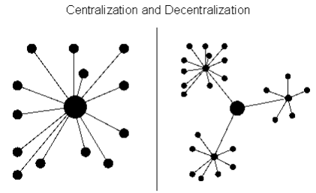
3. Central & Local government relations 3.3 Tax revenue autonomy & fiscal capacity of local governments
Decentralization Theorem (Oates 1972) Social welfare is greater if decisions about type and amount of public goods are allowed to be made locally
Certain degree of autonomy on setting the tariffs and on expenditure decisions required
Conditions:
sufficient technical and administrative capacity
fiscal autonomy to increase amount of local revenues

Slide 12
Presentation outline
Introduction
Basic elements of a good property tax - 2.1 A good tax in general - 2.2 A good local tax - 2.3 Why don’t property taxes live up to their expectations?
Central & Local government relations - 3.1 Central or Local Property Tax - 3.2 Intergovernmental transfers - 3.3 Tax revenue autonomy & fiscal capacity of local governments
Strategies for PT Reform - 4.1 General Strategies - 4.2 Necessary conditions for successful PT Reform - 4.3 Collection Led Strategy vs. Valuation Pushed Strategy - 4.4 Property Tax Administration - 4.5 Building a taxpayers culture - 4.6 Role of central government in PT Reform
Conclusions
Example from VNG International in Ghana

Slide 13
4. Strategies for Property Tax Reform 4.1 General strategies (1)
IMF (Fiscal Monitor)
Broaden tax bases before raising taxes
Rely more on taxing consumption rather tan labor
Strengthen property taxes
Seize opportunities to raise revenue while correcting environmental and other distortions by carbon pricing
IMF:
Advanced economies: flawed design is predominant problem
Other economies: problematic compliance is the problem

Slide 14
4. Strategies for Property Tax Reform 4.2 Necessary conditions for successful PT Reform (1)
Keep tax policy simple and appropriately tailored to existing environment of:
Political will
Legal structure
Institutional capacity across property related agencies
Level of available information on properties and market values
Human resource capacity
Financial resources

Slide 15

4. Strategies for Property Tax Reform 4.2 Necessary conditions for successful PT Reform (2)
Existence of a strong tax administration
Support from taxpayers
Political will is essential
When focus is on assessment base:
Availability of technical expertise
Existing of a cadaster
Existing of a land registration system
Capacity of local government
Solid administrative infrastructure
When PT Reform leads to tax shifts within or among property classes:
Phase-in mechanism is required (compliance) (cushion the impact)

Slide 16
4. Strategies for Property Tax Reform 4.3 Collection Led Strategy vs. Valuation Pushed Strategy (1)
(Source: R. Kelly 2012)
Collection led strategy Strengthen PT-collection by
Improving collection and enforcement with taxpayer service
Less attention on improving quality of property information and accuracy of property valuation.
Collection leads to revenue, equity, efficiency and accountability
Valuation pushed strategy Improving coverage and valuation ratios by focusing on:
Tax mapping
Fiscal Cadaster information
Accurate valuation
Start with Collection led strategy, then followed by Valuation pushed strategy

Slide 17
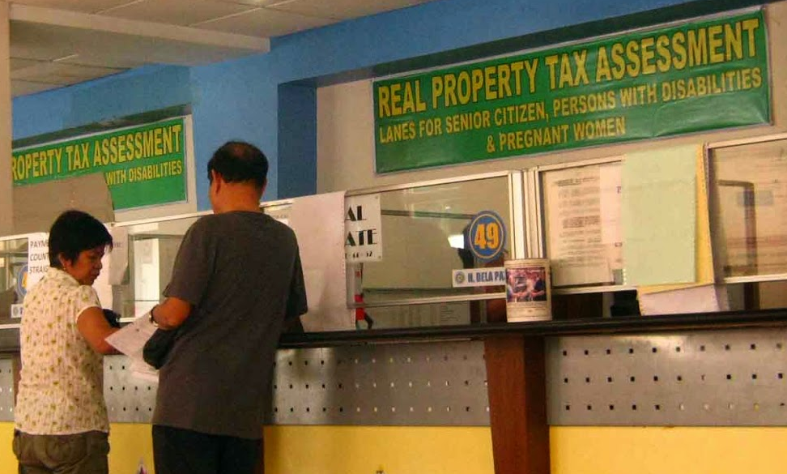
4. Strategies for Property Tax Reform 4.3 Collection Led Strategy vs. Valuation Pushed Strategy: illustration
Example of Quezon (Philippines) (1)
Started with collection-led strategy
PT Reform was linked to Local government management reforms: linking of enhanced revenues with expenditures on improved local services.
Mobilize stakeholder support by linking improved property tax mobilization with improved servicer delivery

Slide 18

4. Strategies for Property Tax Reform 4.3 Collection Led Strategy vs. Valuation Pushed Strategy: illustration
Example of Quezon (Philippines) (2)
Strong political leadership
Excellent technical support
Successful delivery of quality taxpayer education and awareness
Lowering compliance costs
Link improved property tax mobilization with improved service delivery

Slide 19
4. Strategies for Property Tax Reform 4.4 Property tax administration
Research: Tax Administration is main constraint on tax policy in developing countries, due to
Narrow tax base
Exemptions
Ineffective assessment of properties by
Poor market information
Lack of frequent revaluations
Inaccuracies in cadaster
Lack of qualified assessors
Etc.
Low tax rates
Low collection and enforcement and low taxpayer service
“A poorly administered tax may be worse than no tax at all”
Accuracy of property value versus administrative costs: trade off (more accurate costs more)

Slide 20
4. Strategies for Property Tax Reform 4.5 Building a tax payers culture (1)
Besides technical approach also:
Engagement between governments and citizens over tax issues
Tax system can contribute to accountability relationships between government and citizens
Resolving technical issues (narrow tax base, exemptions, etc.) have also effect on compliance of tax payers
Leads to a fair and equitable tax regime
Builds a tax paying culture
Compliance strategy
Not only based on detection and punishment, but also on
Services and trust
Find right balance between expansion of tax base, compliance and enforcement

Slide 21
4. Strategies for Property Tax Reform 4.5 Building a tax payers culture (2)
Revenue enhancement should be linked to quality and quantity of government expenditure: improve public expenditure management and delivery of public services
Property Tax is perceived as a ‘benefit tax’
Accountability of government is improved
Tax reform can become catalyst for improvements in government performance
Improve tax compliance by improving ‘customer service’
Make paying taxes ‘user-friendly’
Reduce administrative costs
Simplify regulation and procedures
Provide information/education
Use mobile apps and websites
Etc.

Slide 22
4. Strategies for Property Tax Reform 4.6 Role of decentralization on PT Reform (1)
Success of PT Reform is dependent on level of decentralization of adequate revenue autonomy in regard to:
Responsibility
Capacity
Resources
Local governments should be given
Adequate and necessary discretion
Accountability constraints
Influence tax policy and administration (at the margin)
Possibility to link PT revenue mobilization with improved service delivery
Intergovernmental transfers and shared taxes should be designed to minimize disincentives for mobilization of local revenues

Slide 23

4. Strategies for Property Tax Reform 4.6 Role of decentralization on PT Reform (2)
Essential for effective decentralization (of PT)
Local government should be able to raise a good share of their revenues by setting tax rates for property tax
Decentralization can be asymmetric:
Full tax administration for large local governments (with more administrative capacity)
Smaller government: limited tax administration functions
>Trade off: efficiency vs. accountability
Authority to change tax base? Only in situations of significant hardship, s.a. circuit breakers
Local authorities should be politically accountable to their communities
Improving tax compliance is shared responsibility of Central government and Local government

Slide 24
Presentation outline
Introduction
Basic elements of a good property tax - 2.1 A good tax in general - 2.2 A good local tax - 2.3 Why don’t property taxes live up to their expectations?
Central & Local government relations - 3.1 Central or Local Property Tax - 3.2 Intergovernmental transfers - 3.3 Tax revenue autonomy & fiscal capacity of local governments
Strategies for PT Reform - 4.1 General Strategies - 4.2 Necessary conditions for successful PT Reform - 4.3 Collection Led Strategy vs. Valuation Pushed Strategy - 4.4 Property Tax Administration - 4.5 Building a taxpayers culture - 4.6 Role of central government in PT Reform
Conclusions
Example from VNG International in Ghana

Slide 25
5. Conclusions
PT can become a good instrument for domestic resource mobilization
Both technical and policy issues have to be addressed
Combine strengths of both central and local government
Improve tax administration
Start with Collection led strategy, then followed by Valuation pushed strategy
Find right balance between expansion of tax base, compliance and enforcement
Get support and compliance from taxpayers
Cushion the impact
Link revenue enhancement to quality of government expenditure
Decentralize adequate revenue autonomy to local government
Intergovernmental transfers should encourage mobilization of local revenues

Slide 26
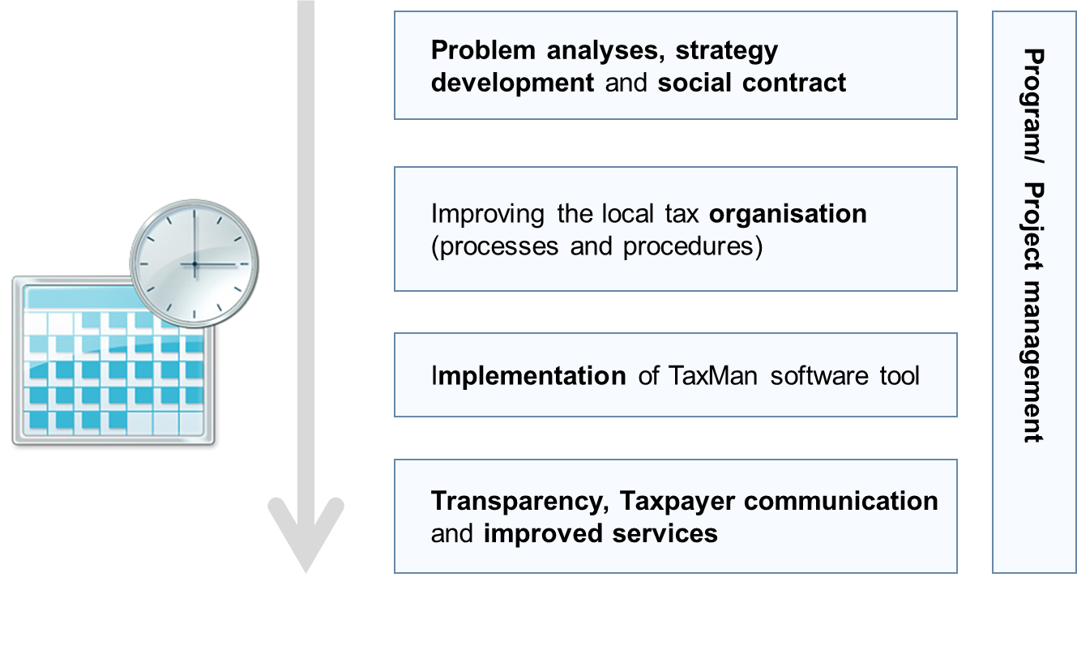
6. Example: VNG International in Ghana
VNG International: International Cooperation Agency of the Association of Netherlands Municipalities
Project: Increase local tax revenues to finance sustainable services in Ghana
Methodology of VNG International:

Slide 27

6. Example: VNG International in Ghana Some results in Ghana (City of Elmina)
City of 35.000 inhabitants
Strategy for increased revenues & improved services;
Council and citizens involved by communication campaigns
Database to levy taxes increased 20 times
Improved procedures and processes implemented;
‘TaxMan’ tool delivered to support municipality with property tax

Slide 28
6. Example: VNG International in Ghana Some results in Ghana
The municipality of Kadjebi has doubled their revenues in a year;
Elmina has increased its base for property tax 20 times;
To increase revenues out of market fees Kumasi successfully involved the so called market queens by negotiating with them which improvements they wanted to be in place in exchange for their help to collect revenues.
Ghana’s big harbour city Tema has been helped to become in control again by helping them to develop a strategy to partially replace expensive third parties which received up to 30% of revenues collected. The strategy includes the use of the free VNG software to levy and collect local taxes.
Sekondi Takoradi has developed policies on revenue collection and ICT, which are being presented to NALAG (Ghana’s association of municipalities) so they can be used for all municipalities

Slide 29


Slide 30
References
Alm, J. & Schroeder, L. (2014) Tax administration and local public finance in developing countries, Asian Journal of Public Administration
Bird, M. & Slack, E. (2002) Land and Property Taxation: A Review
Erdoğdu, M.M., Yilmaz, B.E., Aydin, M. & User, I., The Political Economy of Tax Evasion and Tax Loss in the Real Estate Sector: A Property Tax Reform Proposal for Turkey
Fjeldstad, O.H., Ali M. & Katera, L. (2017) Property Taxation in Developing Countries, CMI Brief, Volume 16, no. 1 (March 2017)
Fjeldstad, O.H. (2014) Tax and development: donor support to strengthen tax systems in developing countries, Public Administration and development, 34, 181-192 (2014)
Grover, R., Törhönen, M.P., Munro-Faure, P., Anand, A. (2016) Achieving implementation of Value-Based Property Tax Reforms in the ECA Region, Paper for 2016 World Bank Conference on Land and Poverty
Haldenwang, C. Von (2017) The Political Cost of Local Revenue Mobilization: Decentralization of The Property Tax in Indonesia, Public Finance & Management 17(2), May 2017
Idowu, A.M., Kamarudin, N., Achu, K., Solomon, I.A. (2016) A Review of Valuation Impact on Property Tax, Sains Humanika
Kelly, R. (2012) Making the Property Tax Work, International Center for Public Policy Working Paper 13-11
Kelly, R. (2000) Property Taxation in East Africa: The Tale of Three Reforms, Lincoln Institute of Land Policy Working Paper
Martinez-Vazquez, J. & Rider, M. (2008) The Assignment of the Property Tax: Should Developing Countries follow the Conventional Wisdom? International Studies Program Working Paper 08-21
Martinez-Vasquez, J. & Sepulveda, C. (2011) Explaining Property Tax Collections in Developing Countries: The Case of Latin America, International Studies Program Working Paper 11-09
Mayor, M., Lyons, S., & Tol, R.S.J. (2010) Designing a property tax without property values: Analysis in the case of Ireland, ESRI Working Paper No. 352, September 2010
Presbitero, A.F, Sacchi, A., Zazzaro, A. (2014) Property tax and fiscal discipline in OECD countries, Economics Letters 124 (2014) 428-433
UCLG Policy paper on local finance. Including the UCLG Support Paper
Why taxes Matter. VNG International methodology to increase revenues for local development, The Hague, December 2016

