Slide 1
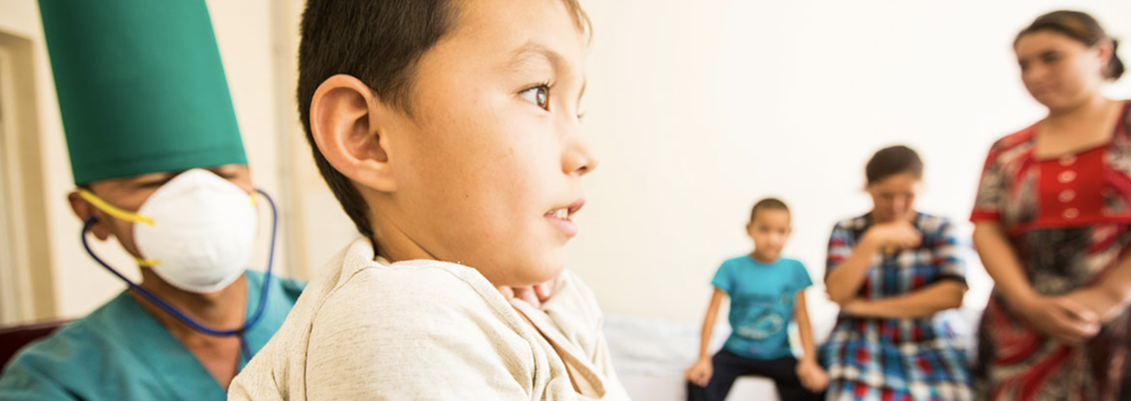
Building a Tuberculosis-free world:
THE LANCET COMMISSION ON TUBERCULOSIS
Photo courtesy Global Fund/John Rae
Embargoed until: March 20th, 2019

Slide 2
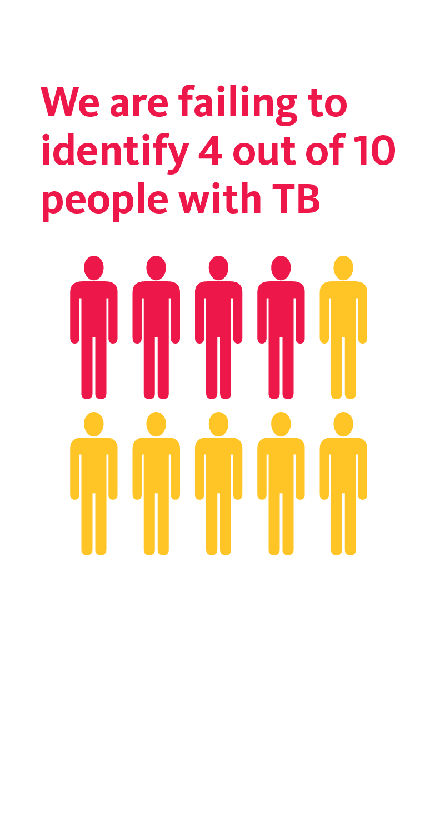
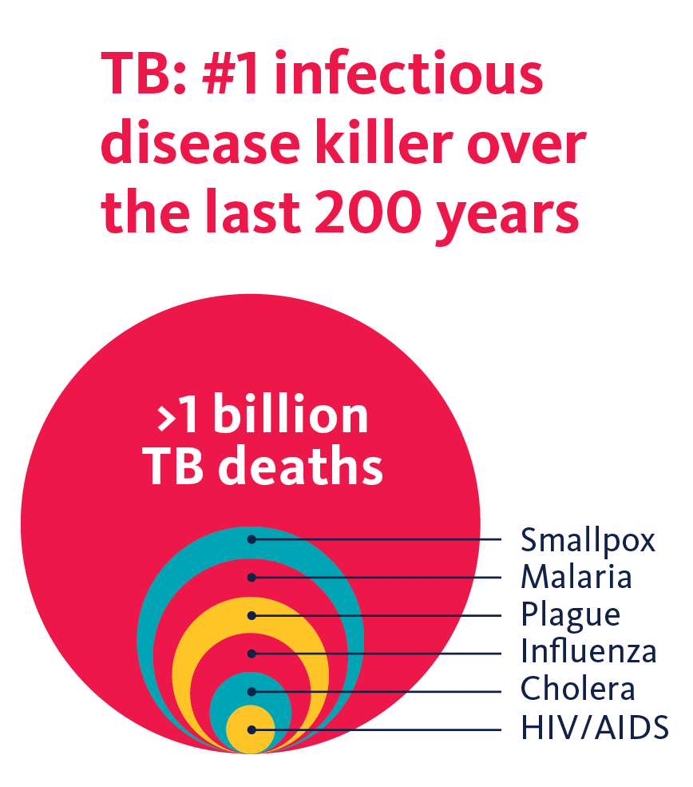

A CRITICAL MOMENT…
Since 2000 57 MILLION lives have been saved due to TB advances, and yet, in 2017 TB caused 1.6 million deaths
Sources: WHO, Global TB report (2018); Paulson T, Nature (2013)

Slide 3
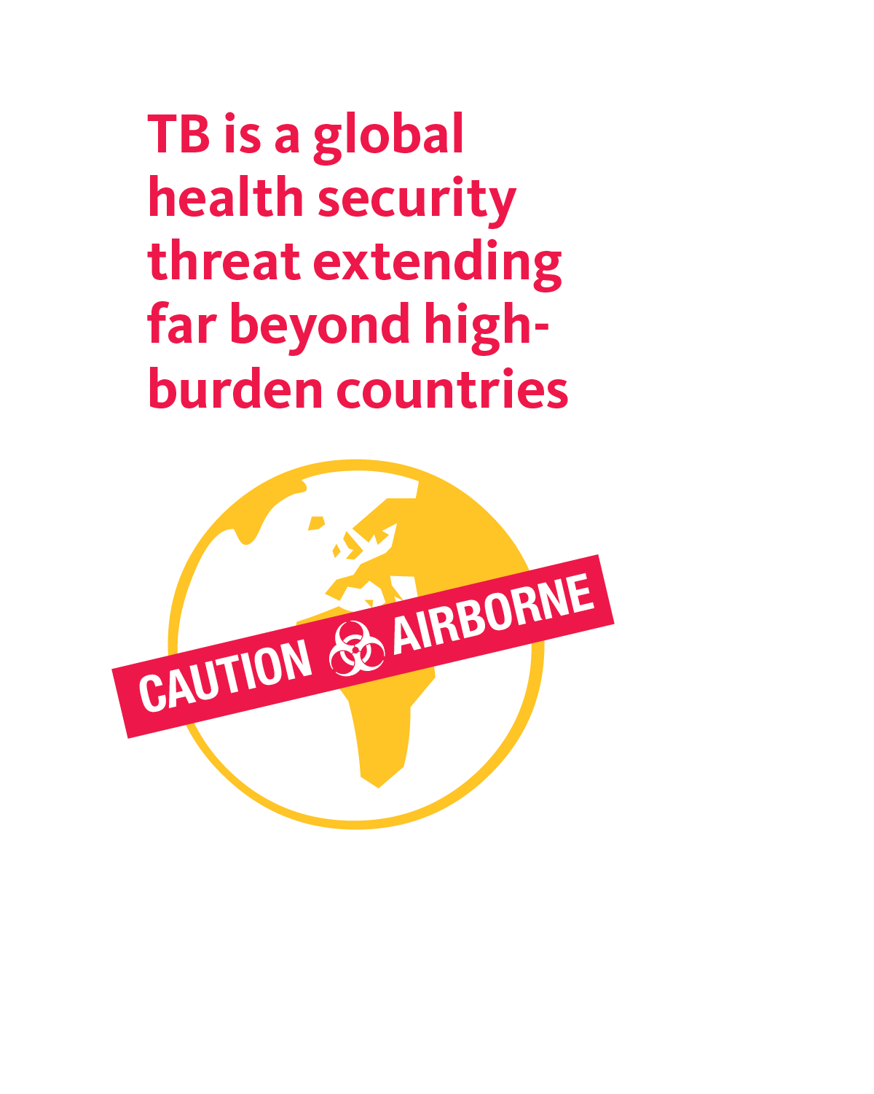
BURDEN OF DISEASE
Private sector: In many of these high burden countries, private sector care provides substantial amount of TB care
Drug Resistant: 85% of DR TB cases are primary transmission. 558,000 cases and 230,000 deaths per year
Sources: WHO, Global TB report (2018); Kendall EA, Lancet Respir Med (2015)

Slide 4


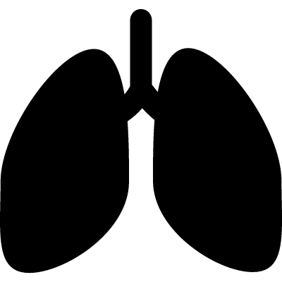










QUALITY OF TUBERCULOSIS CARE
PROCESS OF CARE
QUALITY IMPACT
2 Months
Costs
DIAGNOSTIC DELAY
Wait times
10.0 MILLION
new cases
558 000 new
MDR/RR-TB cases
1/2
1/5
1/5
Drug Susceptible TB
MDR-TB
LTBI
Satisfaction (Additional research needed)
Only
DIAGNOSED
&TREATED
(ADEQUATELY)
TB PATIENTS SPENT
>1/2
annual income
ON CARE
$
1.6 million deaths
Case fatality = 16%
230 000 MDR/RR-TB deaths
Patients lost to follow-up:
4%-38%
POPULATION
GOVERNANCE
PLATFORMS
PROVIDERS
TOOLS
52% HBCs recommend Xpert MTB/RIF as initial test. 47% have implemented this.
1.1 microscopy labs per 100,000
1.3 DST per 5 million
Limited accessibility to TB services at community level
3 health care providers seen before diagnosis
28% - 45%
of providers correctly manage tuberculosis cases
10 sputum smears for every Xpert test in HBCs.
20% are
receiving bedaquiline and delamanid
50-60%
patients begin seeking care in
informal & private sectors
In 8 low-income HBCs, domestic funding represents < 7% of NTP budget needs
FOUNDATIONS
Adapted from Figure 1; Reid, MJA et al (2019). Building a tuberculosis-free world: The Lancet Commission on tuberculosis
Sources: Populations: Chin, D et al, (2017). Governance: Out of Step, Stop TB Partnership (2017), Stop TB Partnership (2014). Platforms: WHO (2014); Huddart, S et al (2016). Providers: Sreeramareddy, C. T., (2014); Das, J (2015); Daniels, B (2017); Sylvia, S (2017). Tools: Cazabon, D (2017); Pai, M (2017). Processes of Care: Sreeramareddy, C. T (2009); Subbaraman, R., (2016); Naidoo, P (2017); Alsdurf, H (2016); MacPherson, P., (2014). Quality Impact: Tanimura, T (2014); Onyeonoro, U. U., (2015); Naidoo, P (2015). Health Outcomes: WHO (2018)

Slide 5
CURABLE & PREVENTABLE:
TB remains major public health emergency
Compared to other major infectious diseases, declines in TB deaths have been slow (rate of change 2000 - 2016)
 | Total deaths (thousands) | Rate of decline, total deaths, 2000 - 2016ª
Tuberculosis ^{b} | 1290 | 1.4%
HIV/AIDS ^{b} | 1010 | 1.9%
Diarrheal diseases ^{c} | 1380 | 2.4%
Vaccine preventable diseases | 274 | 4.6%
Meningitis and encephalitis | 383 | 2.0%
Malaria | 446 | 2.6%
Respiratory infections ^{c} | 2970 | 0.7%
Adapted from Table 2; Reid, MJA et al (2019). Building a tuberculosis-free world: The Lancet Commission on tuberculosis
Sources: WHO, Global TB report (2018); Watkins, D et al. Lancet (2018).
Notes:
This is the average annual rate of decline 2000 - 2016, expressed as percent per year. A negative rate of decline indicates rate of increase. ^{b} To faciliatate cross disease comparisons this table utilized standard classifications of the WHO’s Global Health Estimate, in which tuberculosis deaths in HIV-infected individuals are classified as AIDS deaths ^{c} This category aggregates deaths from a large number of different infectious diseases.

Slide 6
BUSINESS AS USUAL WONT END THE EPIDEMIC….
2045: Countries achieving 90%
reduction in TB mortality cf. 2015 levels
Globally we are not on track to achieve 90% reduction in incidence or 95% reduction in mortality cf. 2015 (SDG targets).
Based on current rates, 90% reduction in TB incidence:
Uganda until 2134
Indonesia until 2129
India until 2124
Adapted from Figure 2; Reid, MJA et al (2019). Building a tuberculosis-free world:
The Lancet Commission on tuberculosis
Projected TB mortality in 2045: green <2015 levels, pink approaching 2015 levels, red >2015 levels
Notes:
Mike, Same here: use the same color palette for the map. Also, text doesn’t make sense to me; should “of” in line 3 be “or”?

Slide 7
UN High-Level Meeting on TB
September 2018
THE WORLD IS PAYING ATTENTION….
  Reach all people by closing the gaps on treatment and prevention
  People-centered response: involve civil society
  Accelerate development of new tools
  Increase Resources
  Accountability

Slide 8
Building a Tuberculosis-free world:
THE LANCET COMMISSION ON TUBERCULOSIS
What are the investment priorities for high burden countries and their partners to realize goals of UN HLM and achieve TB-free world?

Slide 9
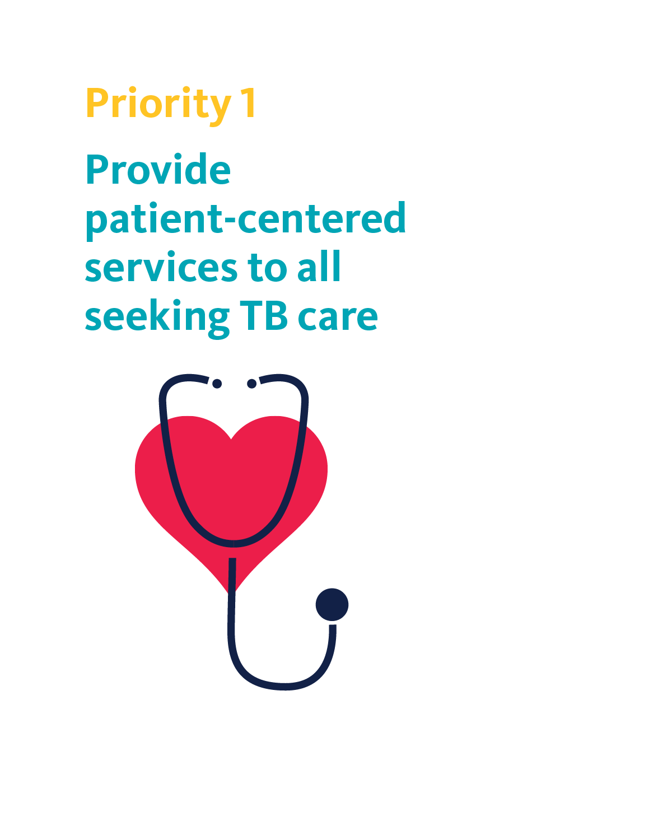
Building a Tuberculosis-free world:
THE LANCET COMMISSION ON TUBERCULOSIS Priority 1
Patient-centered care to all seeking TB care
Provide universal access to drugs & diagnostics for all forms of TB, especially in high MDR-TB burden settings
  Moldova: reduced MDR mortality by 73% by 2045
Prioritize improvements in private sector especially in countries where private sector is substantial
  India: reduced TB mortality by 21% by 2045
Moldova
India
Adapted from Figure 5.; Reid, MJA et al (2019). Building a tuberculosis-free world:
The Lancet Commission on tuberculosis
Notes:
Respond comprehensively to known cases
Reach high-risk populations through active case finding
High quality and equitable care
New models of private sector engagement
Strengthen civil society involvement

Slide 10
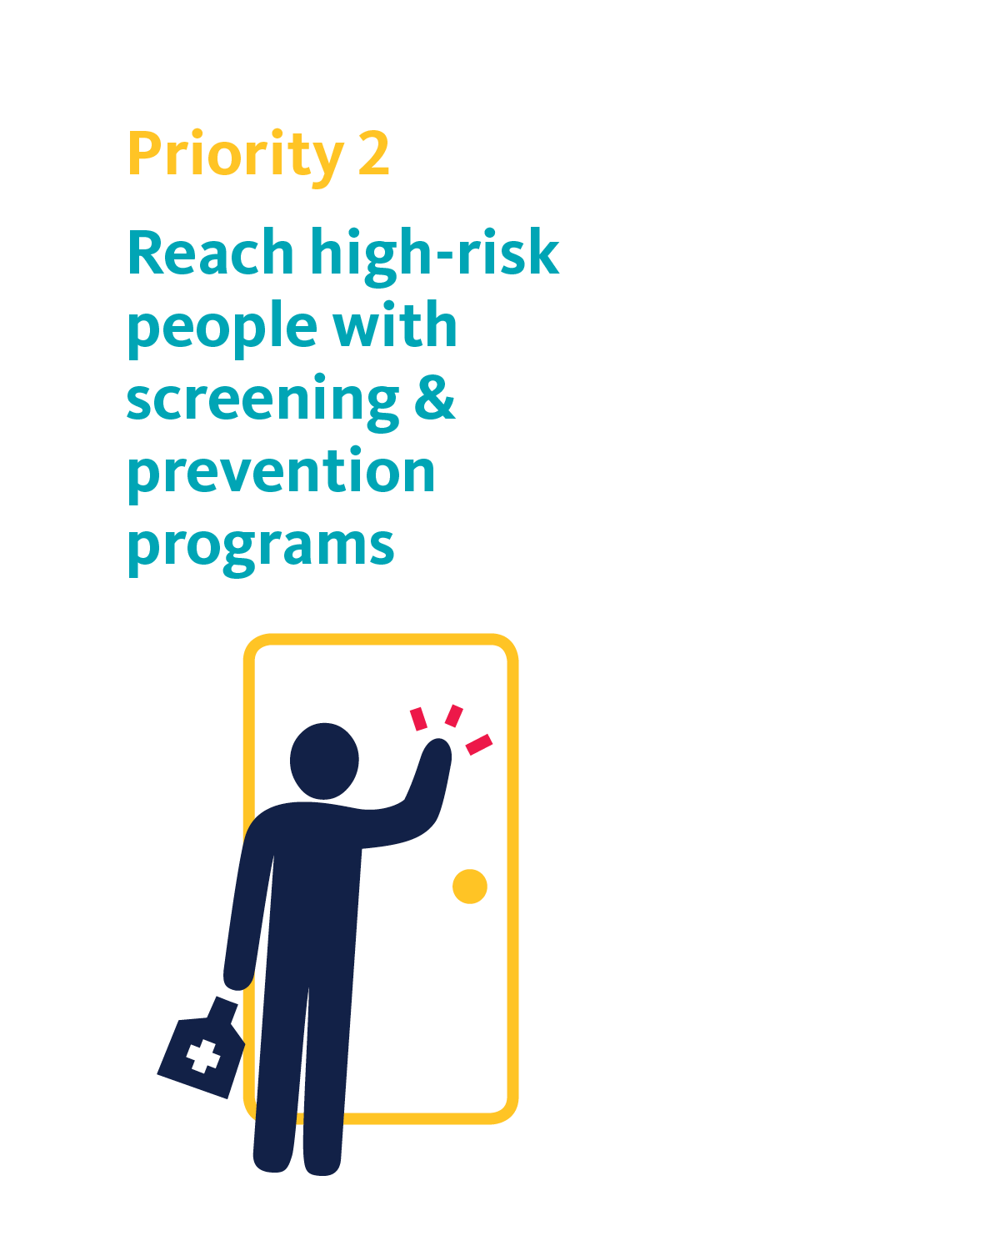
Building a Tuberculosis-free world:
THE LANCET COMMISSION ON TUBERCULOSIS Priority 2
Reach all high-risk people & populations:
Active case finding and TB preventive therapy saves lives
Targeted screening campaigns focused on high risk groups, especially people living with HIV
  Kenya: reduced TB mortality by 33% by 2045
  South Africa: reduced mortality by 46% by 2045
Kenya
South Africa
Adapted from Figure 5.; Reid, MJA et al (2019). Building a tuberculosis-free world:
The Lancet Commission on tuberculosis

Slide 11
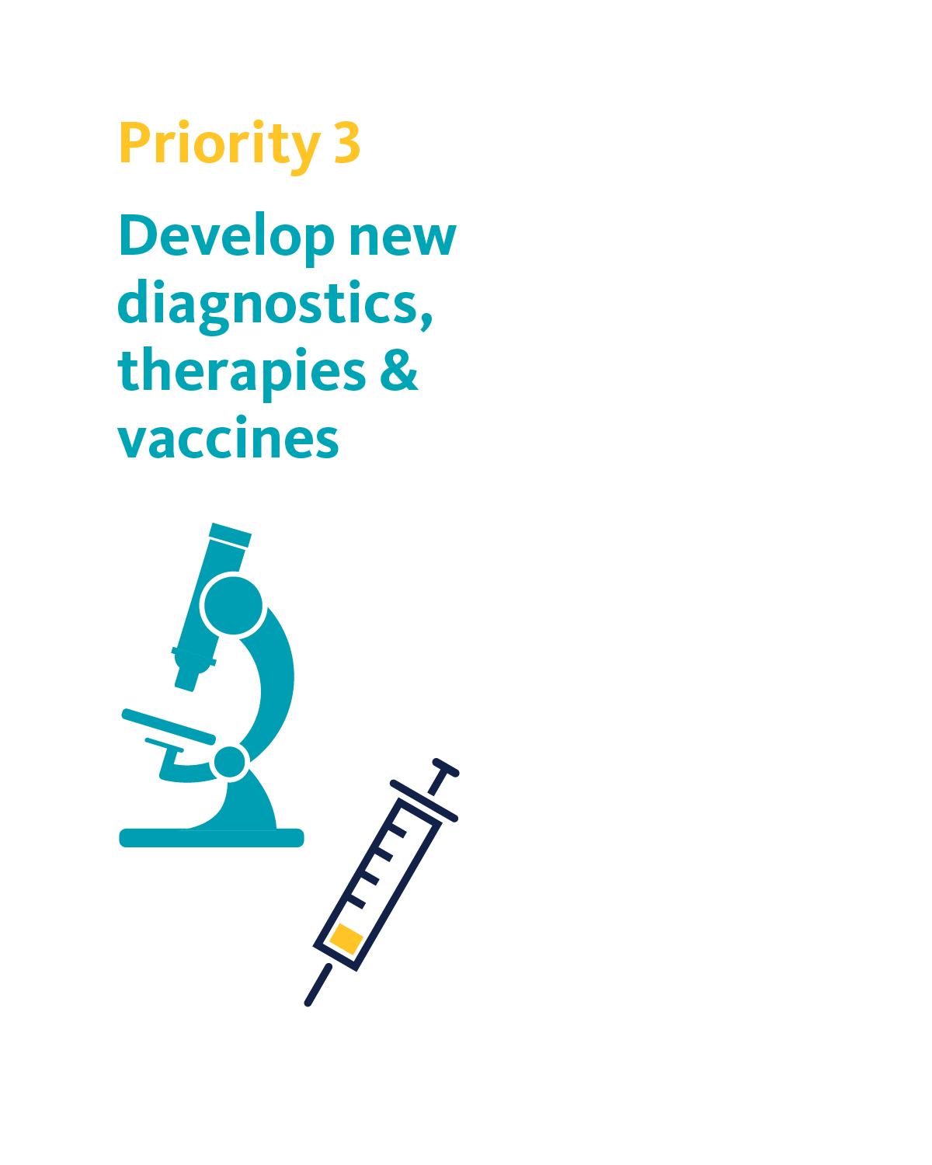
Building a Tuberculosis-free world:
THE LANCET COMMISSION ON TUBERCULOSIS Priority 3
Solutions: Invest to accelerate new tools
India
The cost of R&D inaction is huge: Expressed in monetary terms, ongoing TB deaths, even if we scale up all proven strategies, will cost economies substantially:
India: US$31.7bn per year from unaverted TB deaths
Kenya: US$2.7bn per year from unaverted TB deaths
Moldova: US$35mn per year from unaverted TB deaths
Greater investment in R&D is necessary to avert these deaths
Kenya
Moldova
Adapted from Figure 9; Reid, MJA et al (2019). Building a tuberculosis-free world: The Lancet Commission on tuberculosis
Sources: TAG report (2018)
Notes:
Illustration of the costs of inaction, in TB research. Curative therapy is currently the mainstay of TB control: its maximum impact is realized when patients are put on appropriate treatment as soon as possible. The 'care cascade' highlights stages where patients are lost, in the pathway starting from active disease and ending in treatment completion. To capture the potential impact of curative tools in a simple way, figures show a scenario where current losses in the care cascade are all reduced to 10%, and all delays are reduced by 25%. Additionally for Kenya (a high HIV burden setting), we model an increase in coverage of isoniazid preventive therapy to 90% of HIV cases on ART, as well as an increase of ART coverage to 90% (as in box 3).
Even with such aggressive measures, the figure illustrates ongoing TB burden in each of these different settings. Expressed in monetary terms, these ongoing TB deaths represent a lost value of US$31.7bn, US$2.7bn and US$35mn per year, for the three country settings shown here (in per-capita terms, US$24, US$55 and US$9.8 per person per year, respectively).
Further tools are needed to drive this burden to zero, particularly for primary prevention of TB, in the general population. India's recent National Strategic Plan, for example, calls for increased uptake of preventive therapy, as well as addressing risk factors for TB, such as undernutrition. Supported by R&D, these and other preventive measures, scalable to the population level, would have a profound effect on TB burden.

Slide 12
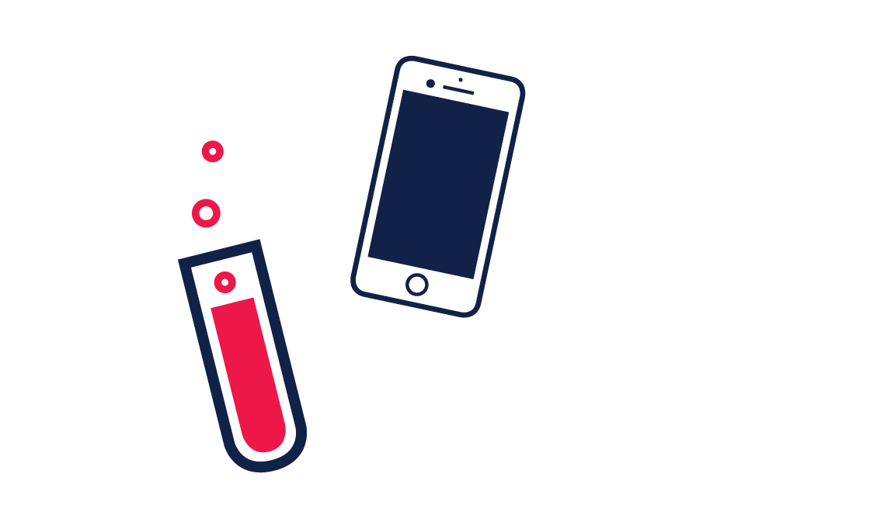
Building a Tuberculosis-free world:
THE LANCET COMMISSION ON TUBERCULOSIS Priority 3
Solutions: Invest to accelerate new tools
Still significant R&D annual funding gap of $1.3 Billion to achieve breakthroughs needed
To close this funding gap:
  Increased funding from LMICs
    Matching grants for R&D
  Creative models of private sector investment
    Pull strategies: e.g., Life Prize
  Continued increased investment from HICs
Sources: Stop TB Partnership (2015); TAG report (2018).

Slide 13
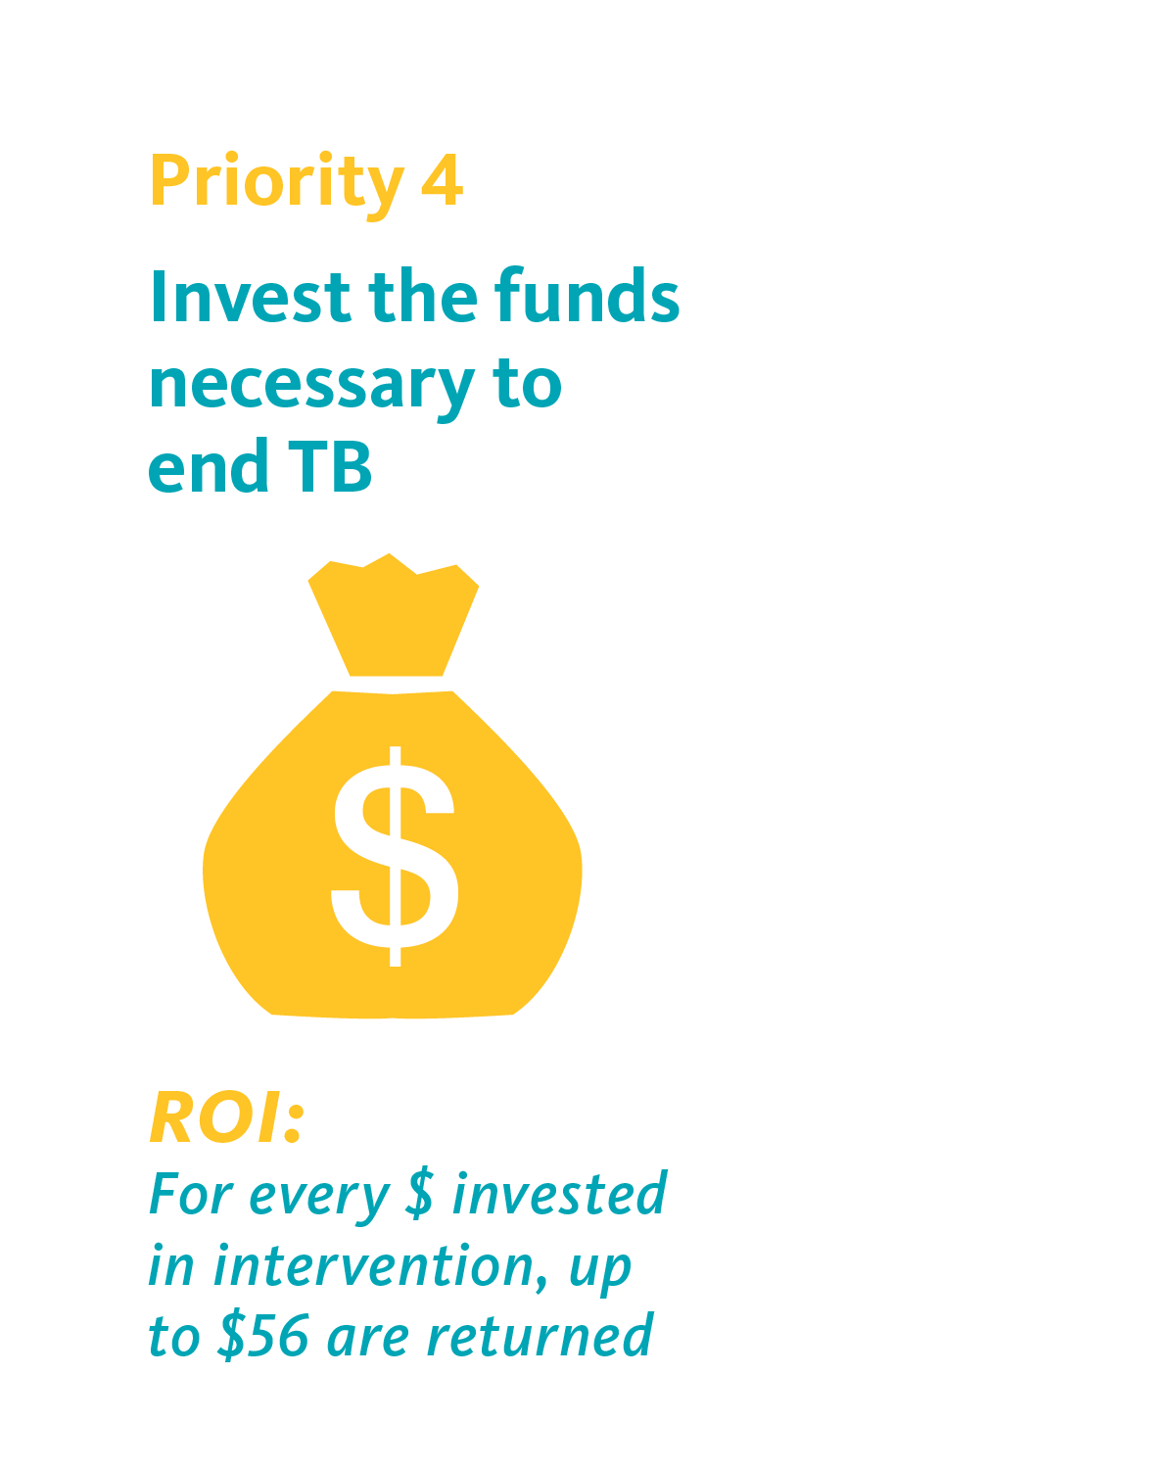
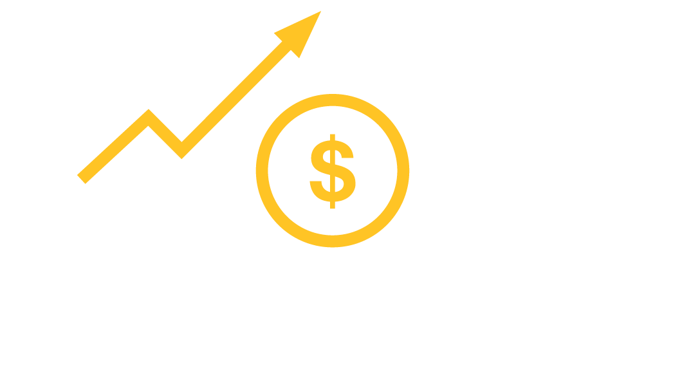
Building a Tuberculosis-free world:
THE LANCET COMMISSION ON TUBERCULOSIS Priority 4
Support sustainable financing
Value of benefits of averting deaths from TB exceeds value of costs by >5 fold
To achieve 90% reduction in TB mortality cf. 2015 levels – demands increase of approx. $5billion per year (above current funding)
Shared responsibility to close gaps & catalyze efforts
Substantially more donor funding crucial to ensure low-income countries can end their epidemics
Source: Vassall A, Copenhagen Consensus (2014)

Slide 14
Building a Tuberculosis-free world:
THE LANCET COMMISSION ON TUBERCULOSIS Priority 4
Increased domestic resource mobilization:
Achieved by prioritizing TB services, increasing tobacco taxation, improved allocation and pooling of heath sector
Examples: China, Bangladesh, Zambia can increase TB expenditure by 500%
Increase in TB expenditures by 2023 from different sources of fiscal space in 28 high-burden countries
Adapted from Figure 10; Reid, MJA et al (2019). Building a tuberculosis-free world:
The Lancet Commission on tuberculosis

Slide 15
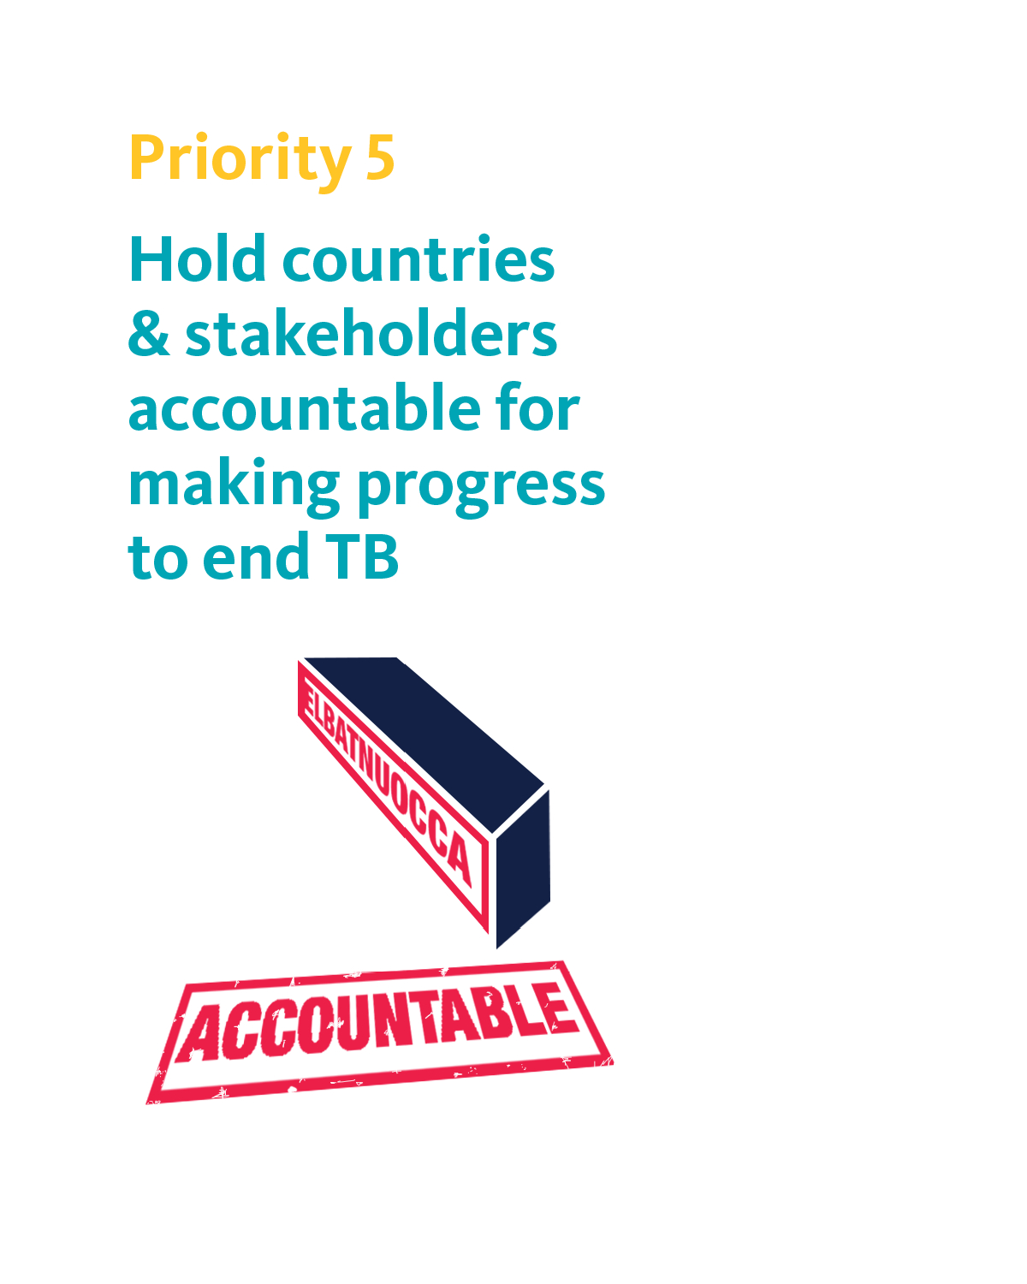
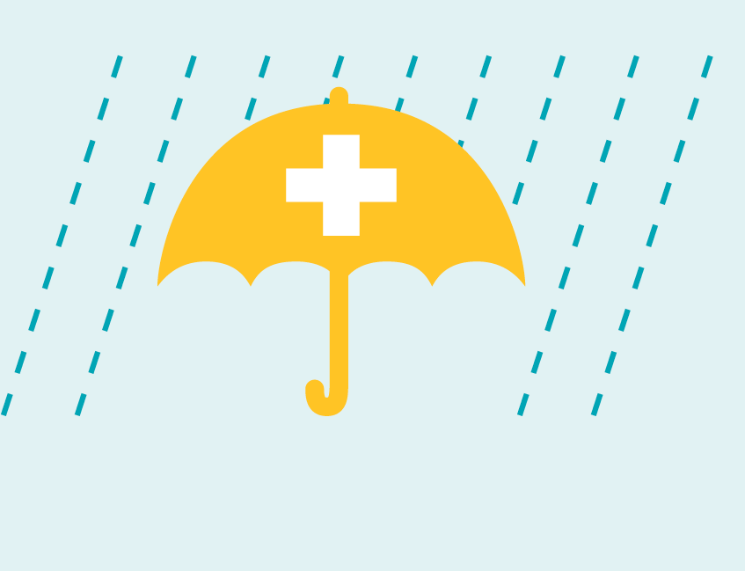
Building a Tuberculosis-free world:
THE LANCET COMMISSION ON TUBERCULOSIS Priority 5
Create enabling environment
Foster greater transparency, demand results
Commit to addressing drivers of TB: HIV, under-nutrition, pollution
Advance Universal Health Coverage agenda

Slide 16
Building a Tuberculosis-free world:
THE LANCET COMMISSION ON TUBERCULOSIS Priority 5
Greater Accountability is essential
TB Observatory: to drive global accountability, engaging experts & stakeholders from all sectors
Report cards
DRAFT

Slide 17
We can build a TB-free world.
With targeted, proven strategies, smart investments based on sound science, accelerated research and development, and a shared responsibility, we can defeat tuberculosis within a generation.
#LancetTBFree
#BuildaTBfreeworld
#ItsTimetoEndTB

Slide 18
Thank You

